Slide 1
Genetic mapping of herbicide resistance and quantitative traits
Jake Montgomery and Brent Murphy
IWGC Conference
9-22-2021
If you are planning to follow along in R, please have the data/scripts downloaded and unzipped from: https://github.com/brentpm2/GWAS_Tutorial and https://github.com/JMont12/qtl_mapping_tutorial
Before/as the session starts, you can install the vcfR, qtl2, and GAPIT packages with the install.packages() function.

Slide 2
Quantitative Trait Loci (QTL) Mapping
Jake Montgomery

Slide 3
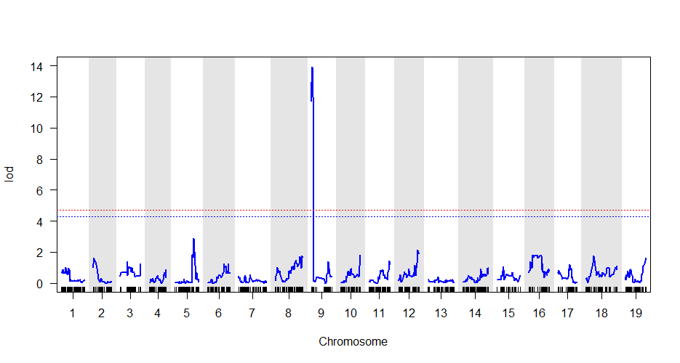
What is QTL mapping?
A genome-wide test to identify regions of the genome that are responsible for a trait of interest (herbicide resistance)
Functions on the assumption that your trait is heritable and caused by some nuclear genetic variant
Inputs: genotypic and phenotypic data from a population segregating for your trait of interest
Output: a list of genomic regions that likely house the genetic element causing your trait of interest
Image: https://avikarn.com/2019-04-23-composite-interval-mapping/

Slide 4
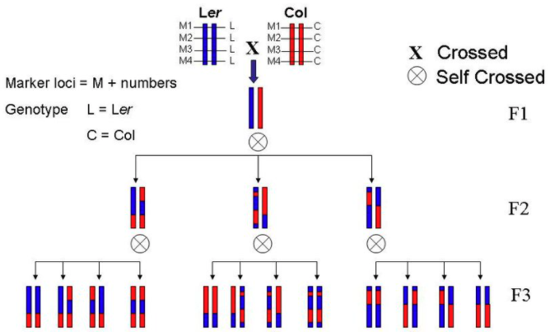
Basic steps of mapping
Identify plants with variation for your trait
resistance surveys, mutagenized populations, screening diversity panels, etc
Sensitive
Resistant
Ishihara 2007

Slide 5
Basic steps of mapping
Identify plants with variation for your trait
resistance surveys, mutagenized populations, screening diversity panels, etc
Create some delimiting assay to separate phenotypes
Delimiting rate, leaf disk assay, translocation/metabolism experiments, etc
Sensitive
Resistant
Ishihara 2007

Slide 6
Basic steps of mapping
Identify plants with variation for your trait
resistance surveys, mutagenized populations, screening diversity panels, etc
Create some delimiting assay to separate phenotypes
Delimiting rate, leaf disk assay, translocation/metabolism experiments, etc
Generate segregating population(s)
F2, backcross, recombinant inbred lines, etc
Sensitive
Resistant
Ishihara 2007

Slide 7
Basic steps of mapping
Identify plants with variation for your trait
resistance surveys, mutagenized populations, screening diversity panels, etc
Create some delimiting assay to separate phenotypes
Delimiting rate, leaf disk assay, translocation/metabolism experiments, etc
Generate segregating population(s)
F2, backcross, recombinant inbred lines, etc
Collect DNA and phenotypes from individuals of said population(s)
Sensitive
Resistant
Ishihara 2007
A
D
A

Slide 8
Basic steps of mapping
Identify plants with variation for your trait
resistance surveys, mutagenized populations, screening diversity panels, etc
Create some delimiting assay to separate phenotypes
Delimiting rate, leaf disk assay, translocation/metabolism experiments, etc
Generate segregating population(s)
F2, backcross, recombinant inbred lines, etc
Collect DNA and phenotypes from individuals of said population(s)
Sequence the collected DNA
RAD-seq, exome capture sequencing, shotgun sequencing, RNA sequencing
Sensitive
Resistant
Ishihara 2007
A
D
A

Slide 9
Basic steps of mapping
Identify plants with variation for your trait
resistance surveys, mutagenized populations, screening diversity panels, etc
Create some delimiting assay to separate phenotypes
Delimiting rate, leaf disk assay, translocation/metabolism experiments, etc
Generate segregating population(s)
F2, backcross, recombinant inbred lines, etc
Collect DNA and phenotypes from individuals of said population(s)
Sequence the collected DNA
RAD-seq, exome capture sequencing, shotgun sequencing, RNA sequencing
Use the following bioinformatic pipeline to identify QTL underlying your trait
Validate identified QTL and test candidate genes with functional genomics
Sensitive
Resistant
Ishihara 2007
Candidate genes
A
D
A

Slide 10
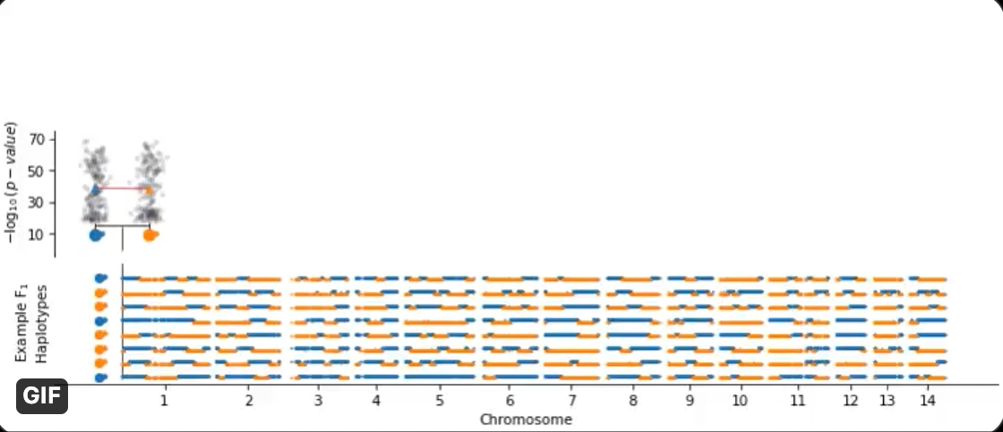
Visualization of QTL genome scan
Image courtesy Collin Roth
https://twitter.com/cullenjnroth/status/1363159662128848899?s=21

Slide 11


Bioinformatic pipeline
Trim raw reads with Trimmomatic
Demultiplex reads into individual files for each sample
Align reads to reference genome with BWA mem
Call genotype variants with GATK
Use the QTL2 package in R to conduct a genome scan to identify QTL
Use the command line to extract genes in identified QTL
Reference Genome

Slide 12
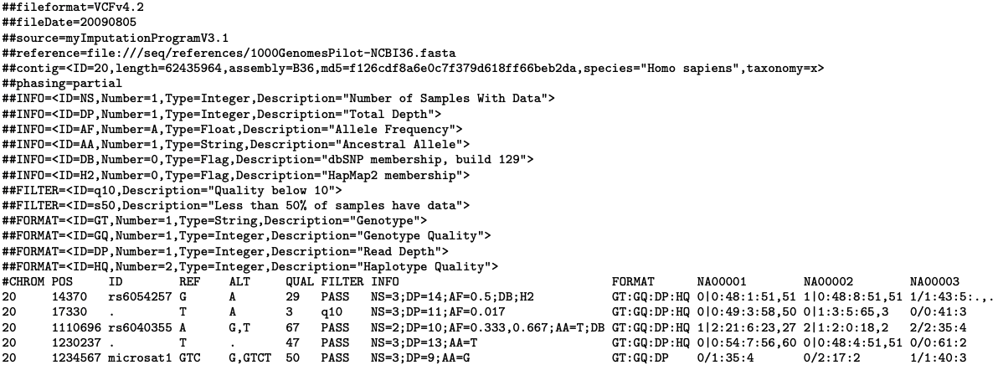
VCF file format
http://samtools.github.io/hts-specs/VCFv4.2.pdf
Header
Samples
Body
Chromosome
Position (bp)
Alternate
Info titles
Reference

Slide 13
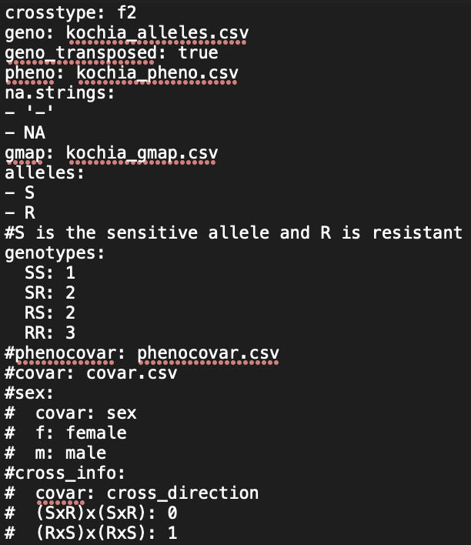
Control file (kochia_qtl_control_file.yaml)
Control file lists all input files used by qtl2
Also specifies important information like:
Cross type
How to specify missing data
What alleles are present
Expected genotypes
Covariate information (not used here)

Slide 14
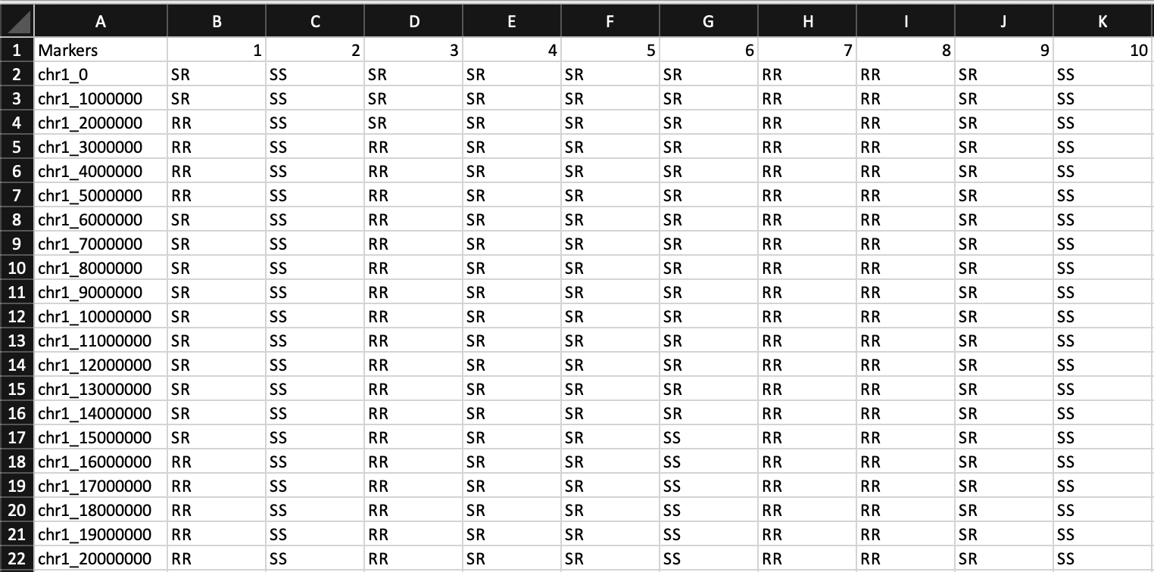
Genotype file (kochia_alleles.csv)
Csv file with markers as rows and samples as columns
Alleles should be assigned based on parental donation
If in this format, geno_transposed should be set to true in control file

Slide 15
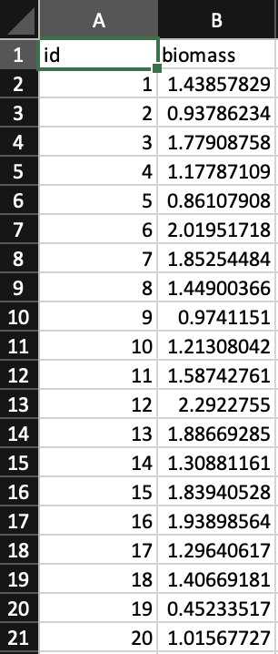
Phenotype file (kochia_pheno.csv)
Csv file with sample ID’s in the first column
Information on phenotype(s) in following column(s)
Here, biomass (in grams) 2 weeks following herbicide application is our phenotype of interest

Slide 16
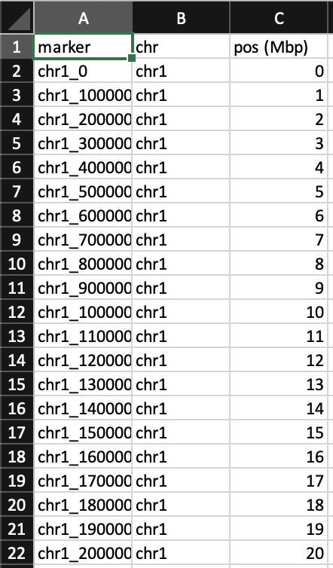
Genetic map file (kochia_gmap.csv)
Csv file with marker ID in the first column
Chromosome and position (either in Mbp or cM) in following columns
This file is used to understand physical distance between markers

Slide 17
Move over to R to go through genome scan
Helpful documentation at https://kbroman.org/qtl2

Slide 18
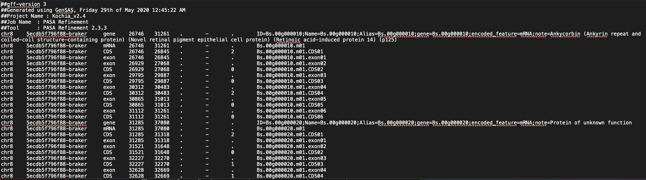
Gff file format
Header
Body
Feature type
End bp
ID fields including annotation
Chromosome
Start bp

Slide 19
Closing points for QTL mapping
Accuracy in phenotyping is essential to reduce error in the QTL scan
Using diverse parents yields more polymorphic sites to use as markers
Genetic mapping is best used in conjunction with other data to refine the resulting list of candidate genes
Reliable annotations are essential for candidate gene discovery
Discovered QTL should be either validated on an independent F2 or candidate genes functionally validated
Fine mapping often follows QTL discovery to reduce the number of candidate genes
This slide set, the R markdown document, and all data are available on github at: (https://github.com/JMont12/qtl_mapping_tutorial)

Slide 20
GWAS tutorial - GAPIT
Brent Murphy

Slide 21
Overview
Introduction
What is GWAS?
Why conduct a GWAS?
GAPIT and the basic code
Inputs
Outputs
Tutorial: Effect of MAF and models

Slide 22
Introduction
What is GWAS?
Why conduct a GWAS?
Experimental design

Slide 23
What is GWAS
Find genetic variations associated with phenotypic variations within an unstructured sample set
Genetic variation is required
Phenotypic variation for the trait of interest is required
Relies on historical recombination events
Identifies Quantitative Trait Nucleotides (QTN)
NOT SUFFICIENT to indicate causation – often identifies linkage blocks where causal variants are found

Slide 24
Why conduct a GWAS?
Identify common genomic regions which control a trait of interest
For a sample set which approaches the population set, these turn into reliable markers
Often provide a smaller window than QTL mapping
Only requires population collection
Do not need to make advanced populations or crosses

Slide 25
When to not conduct a GWAS
Little phenotypic variation for the trait of interest
Investigating a rare variant
Have low sample size (bigger the better, approx. 300 for plants)
Have low marker coverage
To avoid missing regions, LD > marker density

Slide 26
GAPIT
Genome Association and Prediction Integrated Tool
R – code is short and friendly, makes pretty graphs
Routinely updated
Implements multiple models for GWAS and genomic prediction
Can produce most required model inputs internally

Slide 27
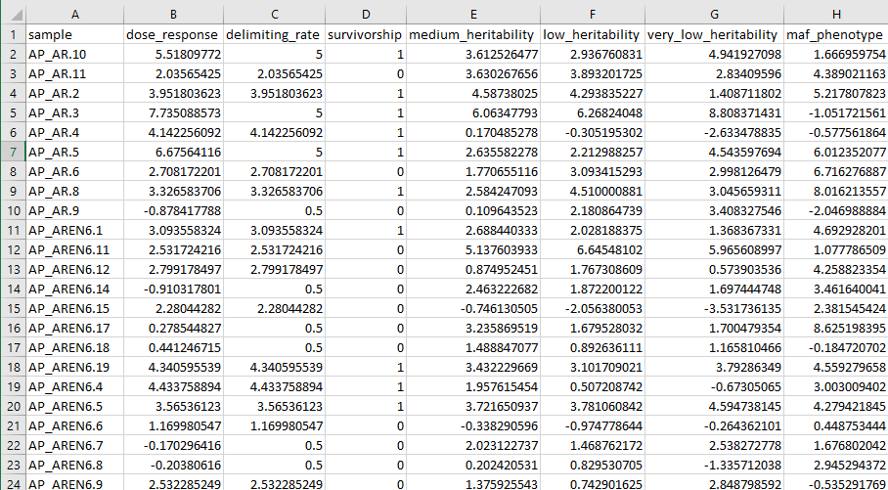
GAPIT – Required Inputs
Phenotypic data
Rows = samples, corresponding with genotypes label
Columns = distinct phenotypes
Missing data is allowed

Slide 28
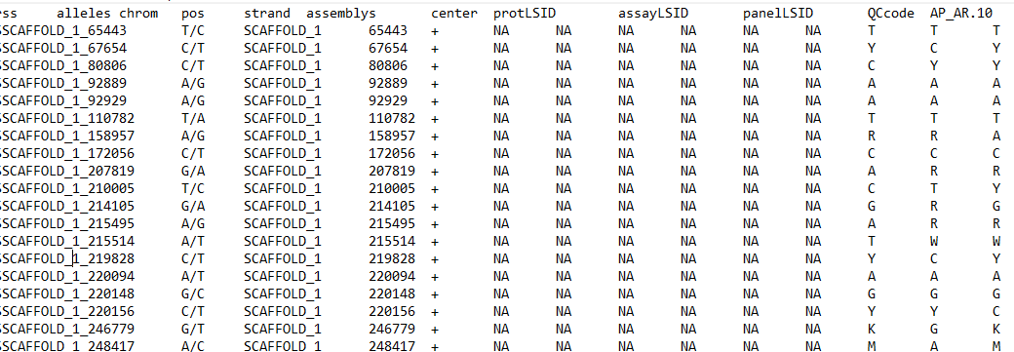
GAPIT – Required Inputs
Genotypic data
Stored in hapmap or numeric format
Best if complete data, imputation can fill gaps

Slide 29
Tutorial – load GAPIT and inputs
Launching R mirror – GAPIT should already be loaded
my_packages <- library()$results[,1]
“GAPIT3” %in% my_packages
Load phenotypes
Phenotypes <- read.table(“/path/to/phenotypes”, header = T)
head(phenotypes,10)
Load genotypes
Genotypes <- read.table(“/path/to/genotypes”, header = F)
dim(genotypes)

Slide 30
Tutorial: Model selection and MAF
Test different models to determine which one has:
Best looking QQ-plot
Most true positives and fewest false positives
True variants are in “true_variants.txt”
Set output directory
setwd(“./model_selection”)
Run GAPIT
Using a subset of models for time constraint
my_gapit <- GAPIT(Y=phenotypes[,c(1,8)], GD=myGD, GM=myGM, PCA.total=3, model=c("GLM","MLM","FarmCPU","Blink“) )

Slide 31
GAPIT – Diagnostic Outputs
Phenotypic diagnosis
Check trait distribution
Marker density vs LD decay
Want a higher marker density than LD decay, otherwise miss parts of genome
Levels of heterozygosity
Good check if you are working with inbreds, too much heterozygosity lowers marker informativeness
PC plots
Visualization of “Q”, population structure
Kinship plot
Visualization of “K”, pairwise relatedness between samples
QQ-plot
A good diagnostic for model comparison
A good model will only see deviations at the upper right section of the graph

Slide 32
GAPIT – Results Output
Manhattan plots
Chromosomes and variant positions on the X axis
-log₁₀(P-values) on Y axis
Variants which cross the threshold line are significant
Association table
Contains more information, such as importance of a given variant in the model, adjusted P value, and (model dependent) allele effect
Optimum compression settings
Estimates heritability

Slide 33
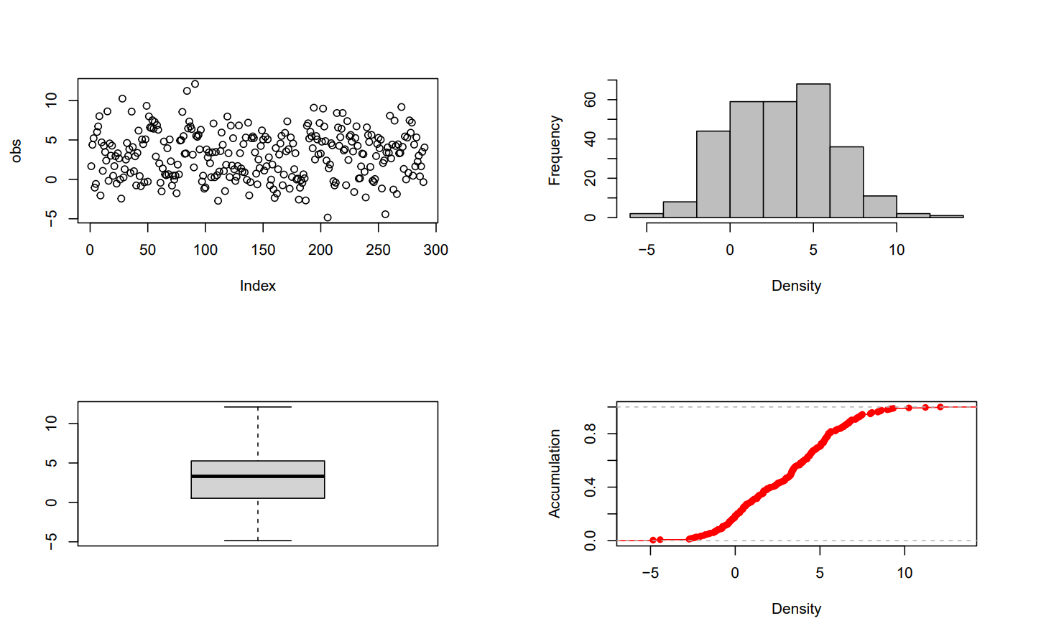
Phenotype view

Slide 34
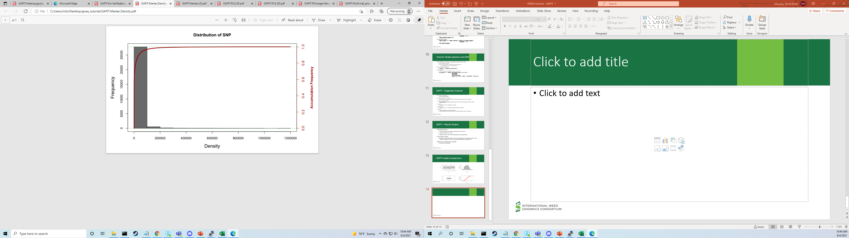
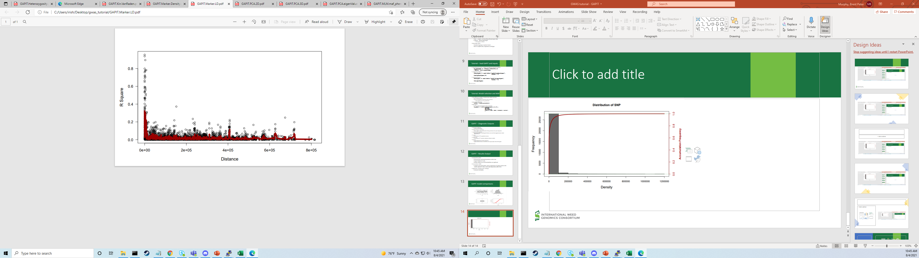
Marker density VS LD decay

Slide 35
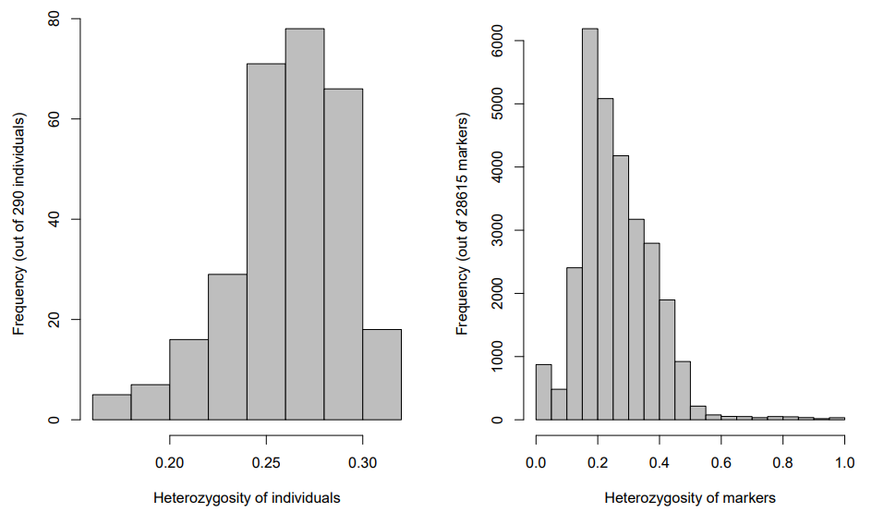
Heterozygosity

Slide 36
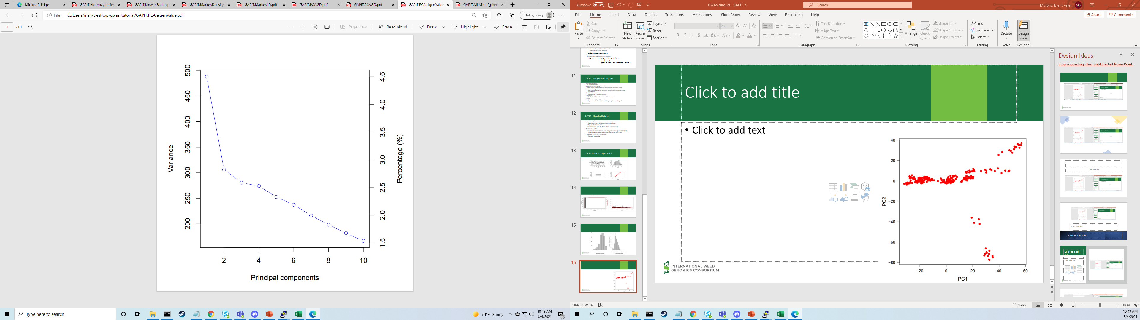
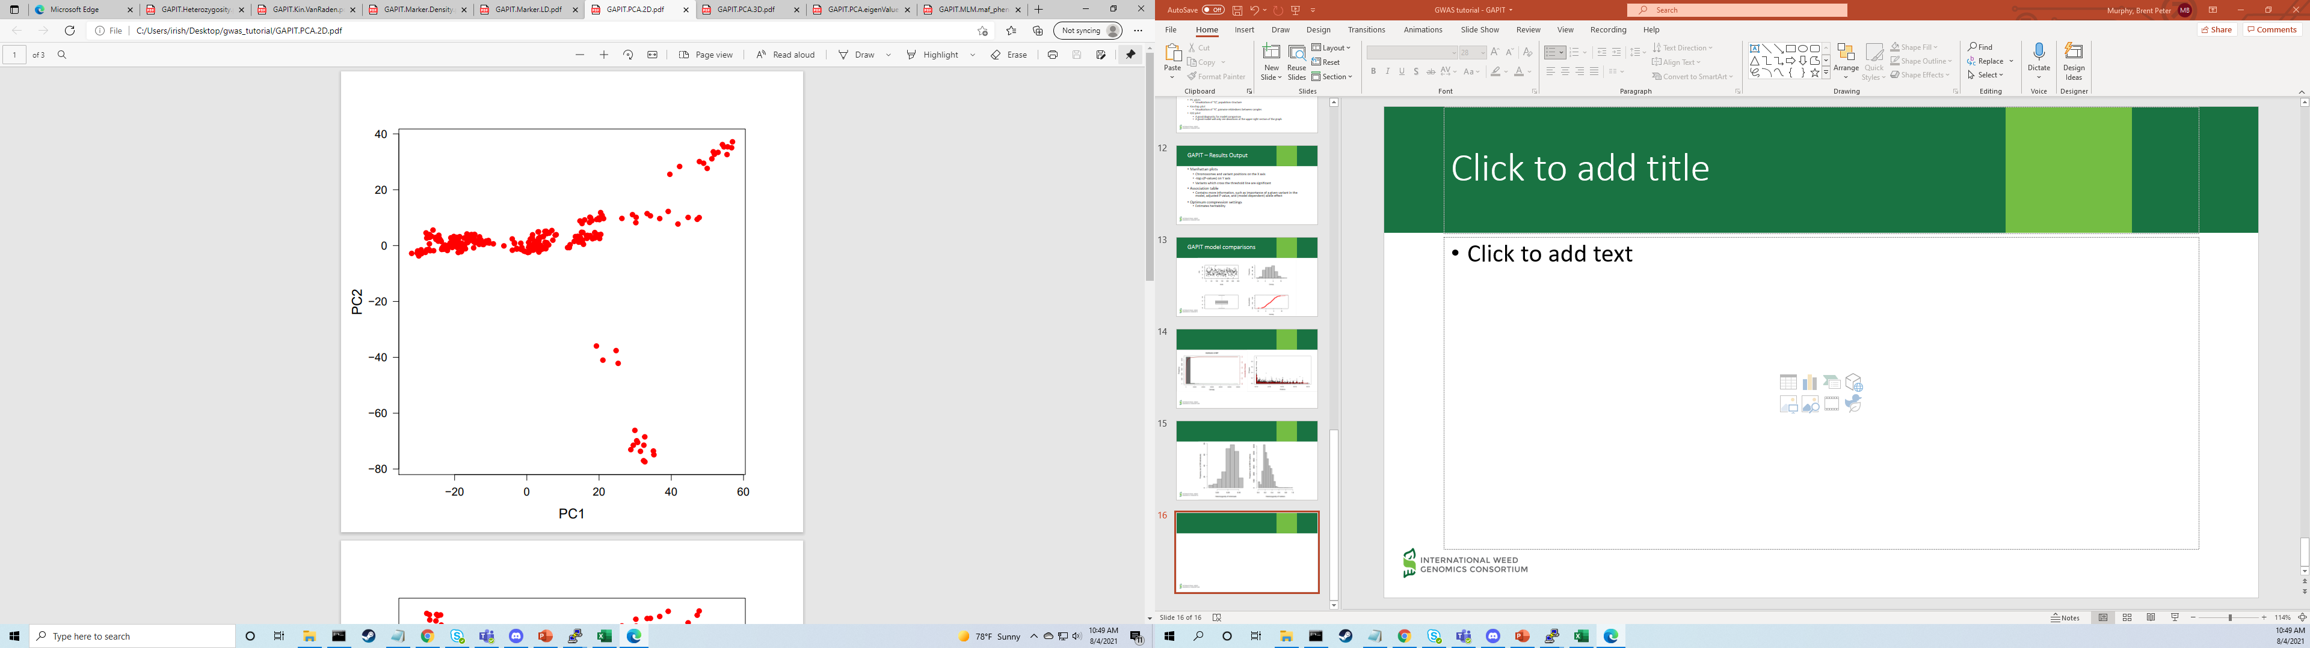
Population structure (Q)

Slide 37
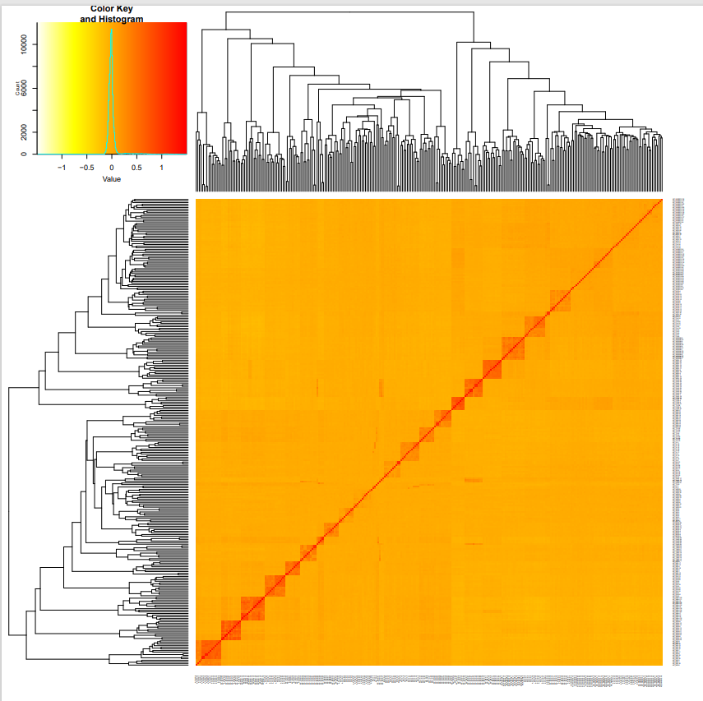
Kinship (K)

Slide 38
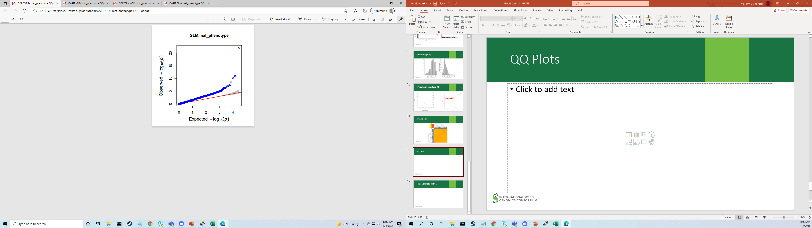
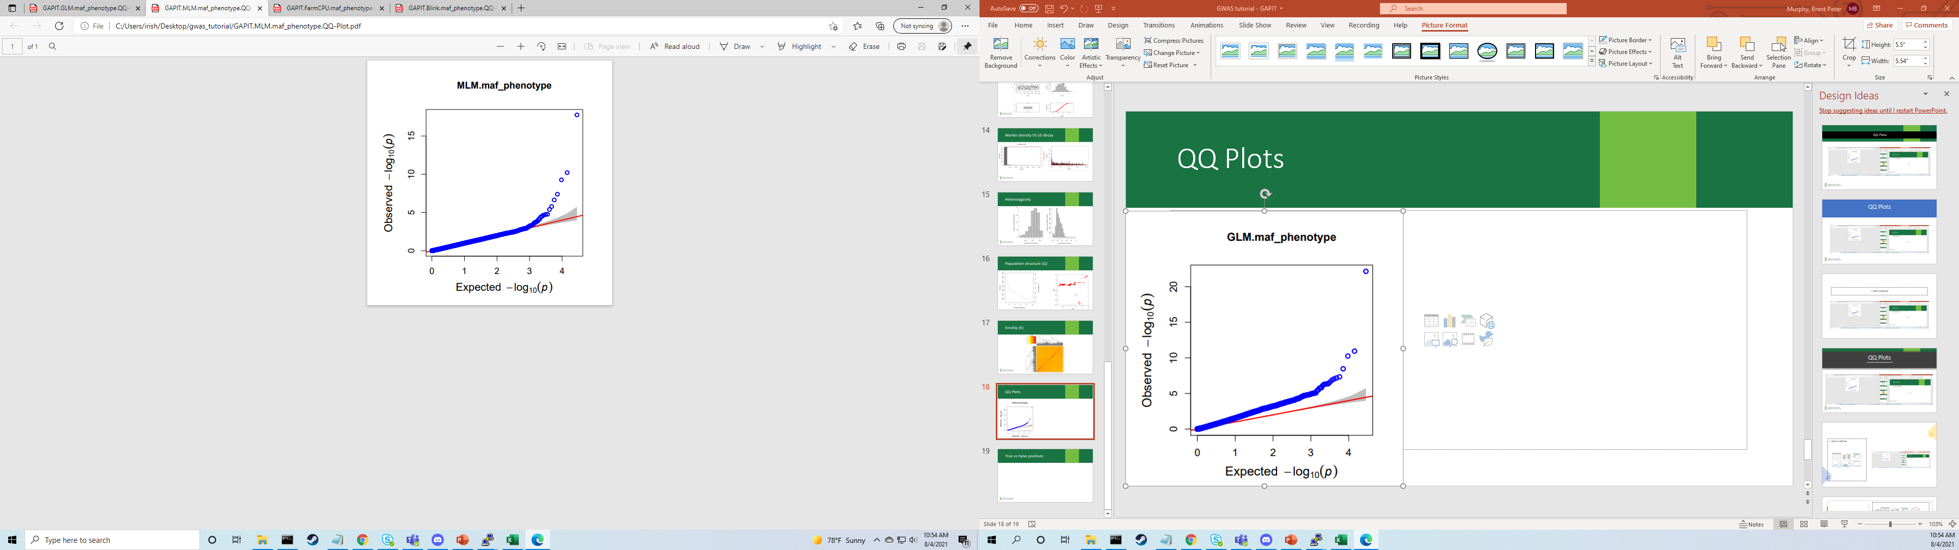
QQ Plots

Slide 39
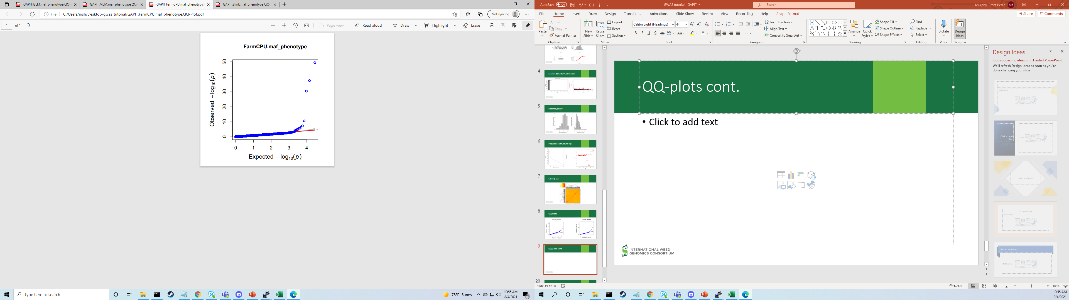
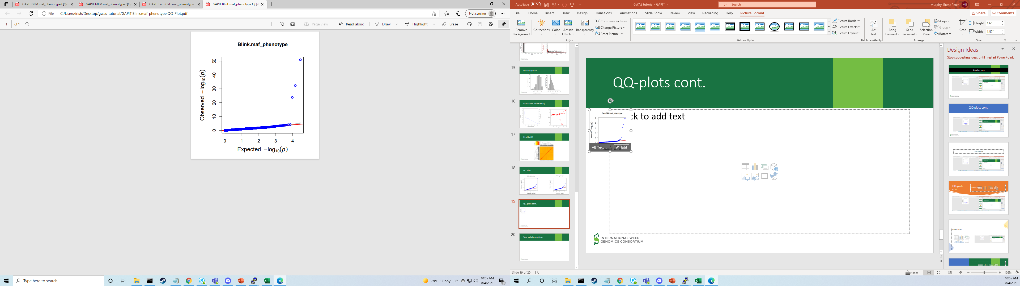
QQ-plots cont.

Slide 40
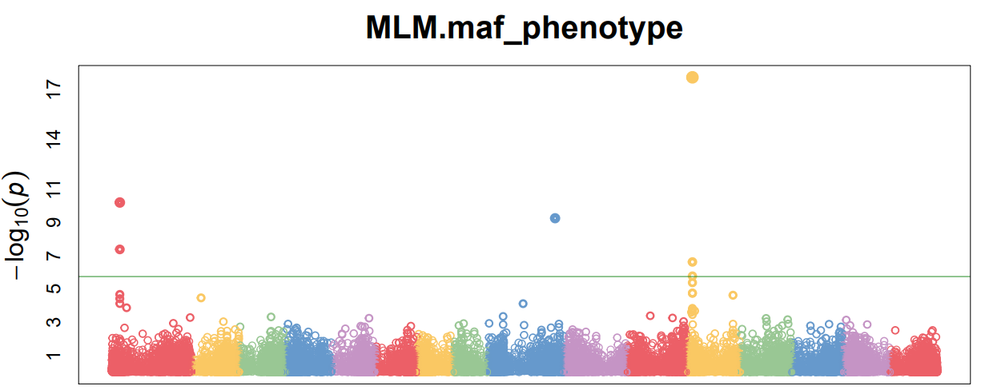
True vs False positives
GLM: 205 significant QTN
3 true positives
Numerous false positives
MLM: 7 significant QTN
3 true positives + several linked alleles
0 false positives
FarmCPU: 10 significant QTN
3 true positives
7 false positives
Blink: 3 significant QTN
3 true positives
0 false positives

Slide 41
Tutorial 2: Trait heritability
Change output directory
setwd("../gapit_heritability")
Run GAPIT with MLM model
my_gapit <-GAPIT(Y=phenotypes[,c(1,5,6,7)], GD=myGD, GM=myGM, PCA.total=3, model=c("MLM") )

Slide 42
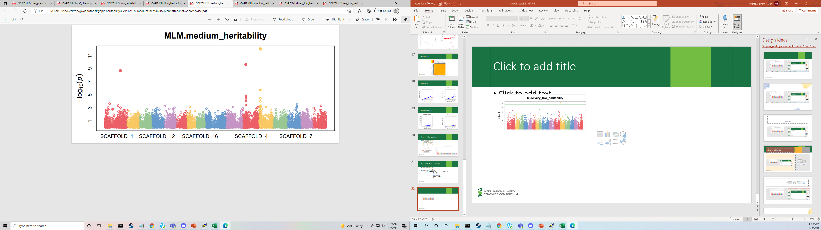
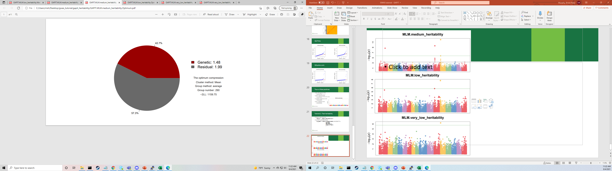
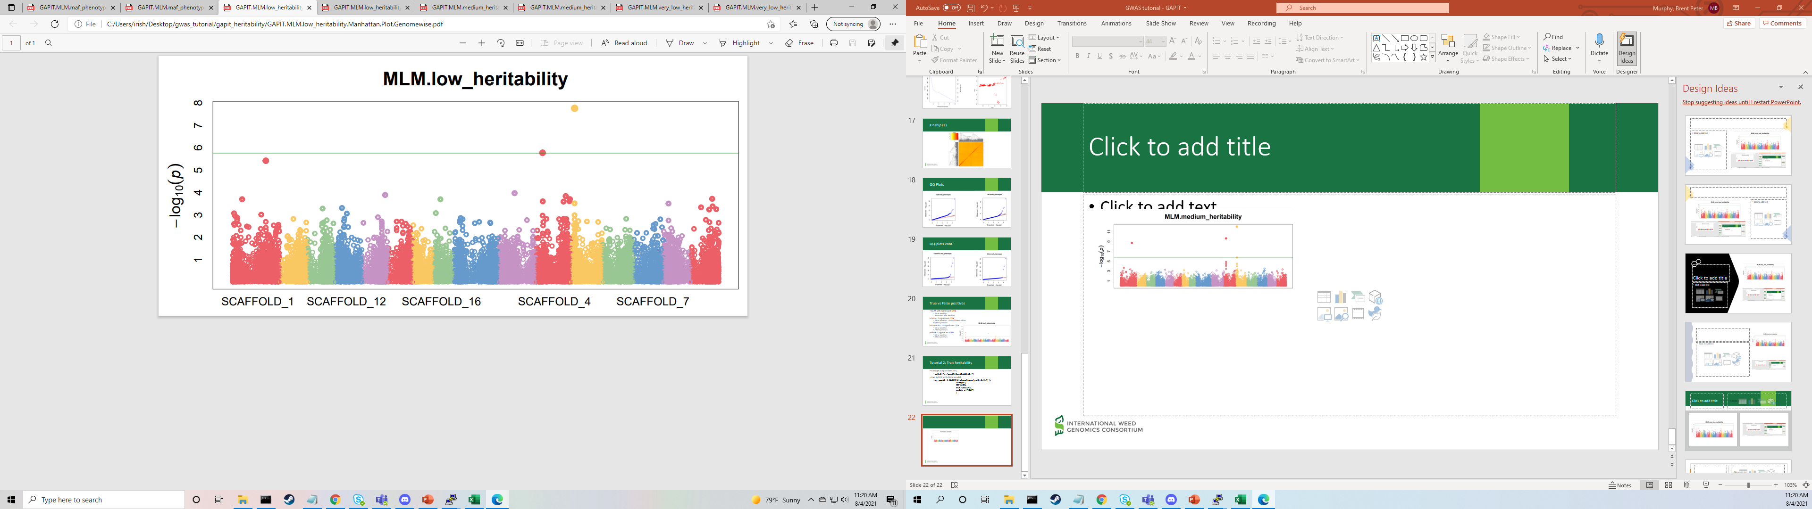
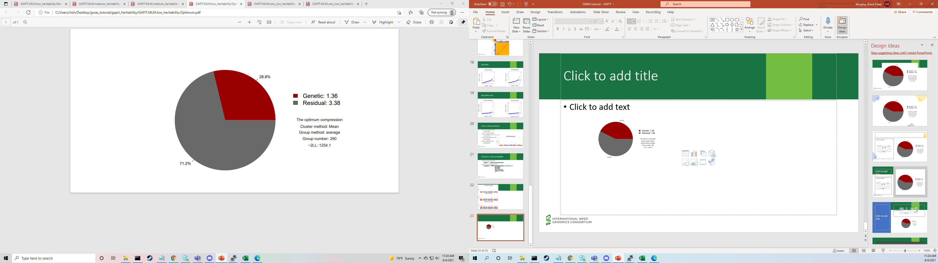
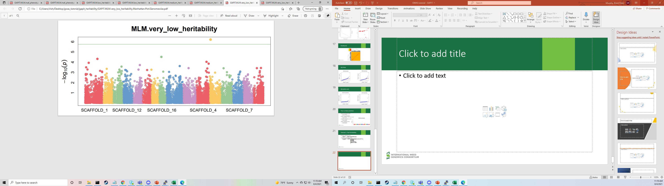
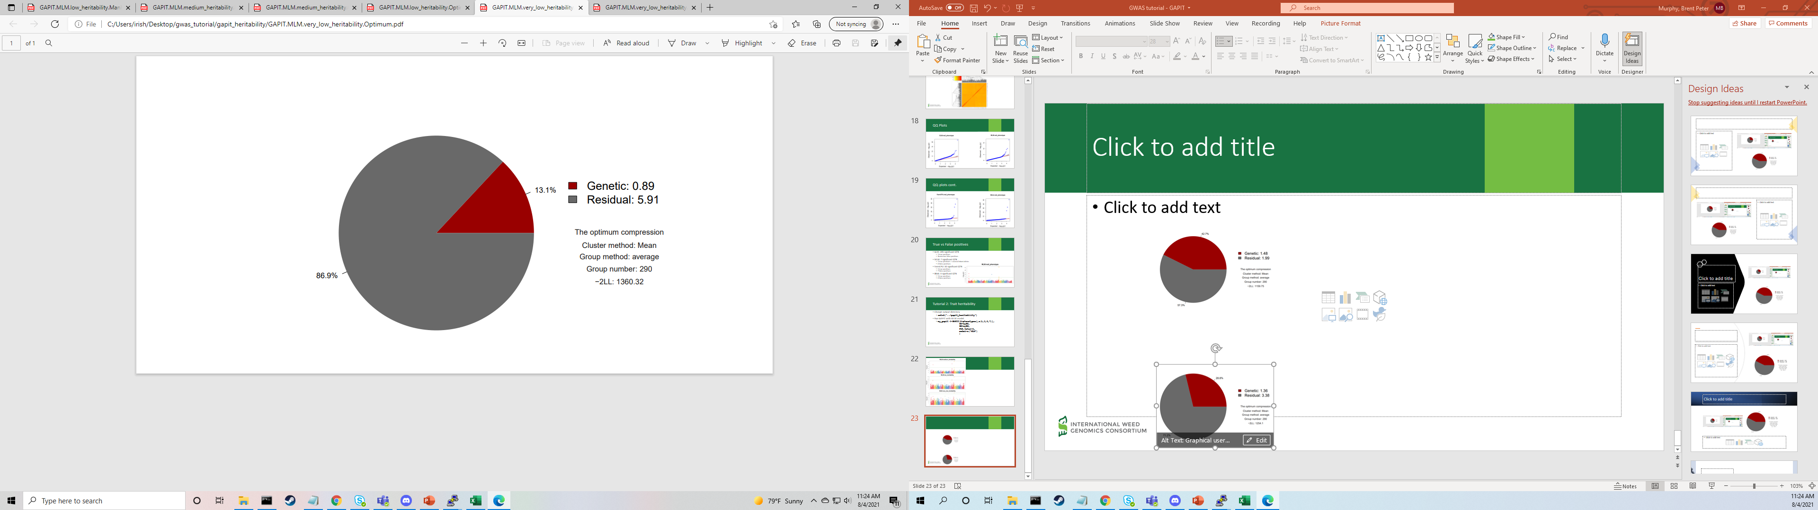

Slide 43
Tutorial 3: Phenotyping Strategy
All phenotypes are derived from the same simulation
All alleles have the same effect size
Dose-response
True phenotypic variation + error, same as previous tutorials
Delimiting rate
Extreme values are binned (<0.5 = 0.5; >5 = 5)
Survivorship
Straight threshold (> 3 = 1; <= 3 = 0)

Slide 44
Tutorial 3: Phenotyping Strategy
Change output directory
setwd("../gapit_phenotyping")
Run GAPIT
my_gapit <- GAPIT(Y=phenotypes[,c(1,2,3,4)], GD=myGD, GM=myGM, PCA.total=3, model=c("MLM") )

Slide 45
